Slide 1


A Primer on Time Series Analysis
P. Boily, Ph.D.
Idlewyld Analytics and Consulting Services
February 2016

Slide 2
Outline
I. Time Series Decomposition
Basic Concepts Models Calendar Effects Seasonal/Cyclical Adjustment Methodology Data Quality Issues
II. Forecasting Models
Basic Concepts Detrending Time Series Data Notation and Forecast Evaluation Filtering Methods Other Considerations
III. Dealing With Missing Data
IV. Automated Trend Extraction

Slide 3
I. Time Series Decomposition Basic Concepts
A time series is a sequence of values, measured at regular intervals over time. Ideally,
the reporting periods should be identical (e.g. daily, monthly, quarterly or yearly);
the measurements should be taken over discrete (exclusive), consecutive periods,
the concepts and the measurement approach should be consistent over time.
In order to identify correlations and root causes by analyzing the relationships between the variables, one must assume that they are independent of time (or stationary). Statistical tools which assume data independence are invalidated if the data is not actually independent of time, that is if it is serially dependent.
When serial dependence is suspected or expected to exist, time series decomposition is required to identify trend, cyclical and seasonal components, in addition to providing accurate forecasts. The time series seasonal adjustment enables the identification of turning points and provides consistent comparisons of indicators across time periods.

Slide 4
I. Time Series Decomposition Basic Concepts – Components Hierarchy
Time series data can be broken down as follows:
Time Series
Trend
Seasonality & Cycles
Irregular
Seasonal & Cyclical
Calendar
Moving Holiday
Trading Day

Slide 5
I. Time Series Decomposition Basic Concepts – Breaks
In order to remove serial dependence, one must extract the trend and seasonal effects.
Before carrying out seasonal adjustment, it is important to identify and pre-adjust for structural breaks (using the Chow test, for instance), as their presence can give rise to severe distortions in the estimation of the Trend and Seasonal effects.
Seasonal breaks occur when the usual seasonal activity level of a particular time reporting unit changes in subsequent years.
Trend breaks occurs when the trend in a data series is lowered or raised for a prolonged period, either temporarily or permanently.
Sources of these breaks may come from changes in government policies, strike actions, exceptional events, inclement weather, etc.

Slide 6
I. Time Series Decomposition Models
Traditionally, the decomposition follows one of three models:
Multiplicative
Additive
Pseudo-Additive
The choice of a model is driven by data behaviour and choice of assumptions (more on this in the following slides).
The X12 model automates some of the aspects of the decomposition, but manual intervention and diagnostics are still required. X12 is implemented in SAS and R, among other platforms. Consult the references for more information.

Slide 7
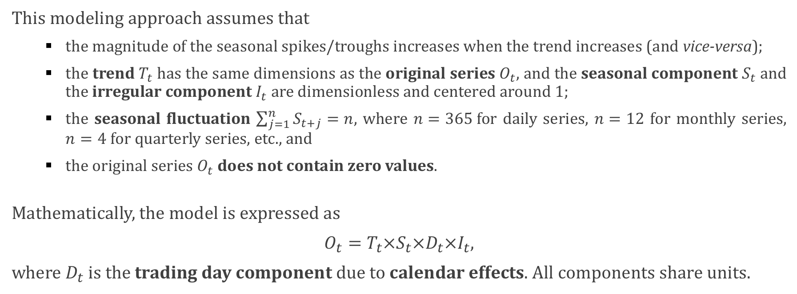
I. Time Series Decomposition Models – Multiplicative
This modeling approach assumes that
the magnitude of the seasonal spikes/troughs increases when the trend increases (and vice-versa);
the trend $T_{t}$ has the same dimensions as the original series $O_{t}$, and the seasonal component $S_{t}$ and the irregular component $I_{t}$ are dimensionless and centered around 1;
the seasonal fluctuation $\sum_{j=1}^{n}{S_{t+j}=n}$, where $n=365$for daily series, $n=12$ for monthly series, $n=4$ for quarterly series, etc., and
the original series $O_{t}$ does not contain zero values.
Mathematically, the model is expressed as
$O_{t}=T_{t}×S_{t}×D_{t}×I_{t},$
where $D_{t}$ is the trading day component due to calendar effects. All components share units.

Slide 8

I. Time Series Decomposition Models – Multiplicative
After seasonality adjustment, the seasonality adjusted series is
${SA}_{t}={\frac{O_{t}}{S_{t}×D_{t}}=T}_{t}×I_{t}.$
After a log transformation, the multiplicative model becomes an additive model:
$$\text{log} O_{t}={\text{log} T}_{t}+{\text{log} S}_{t}+{\text{log} D}_{t}+\text{log} I_{t}$$

Slide 9
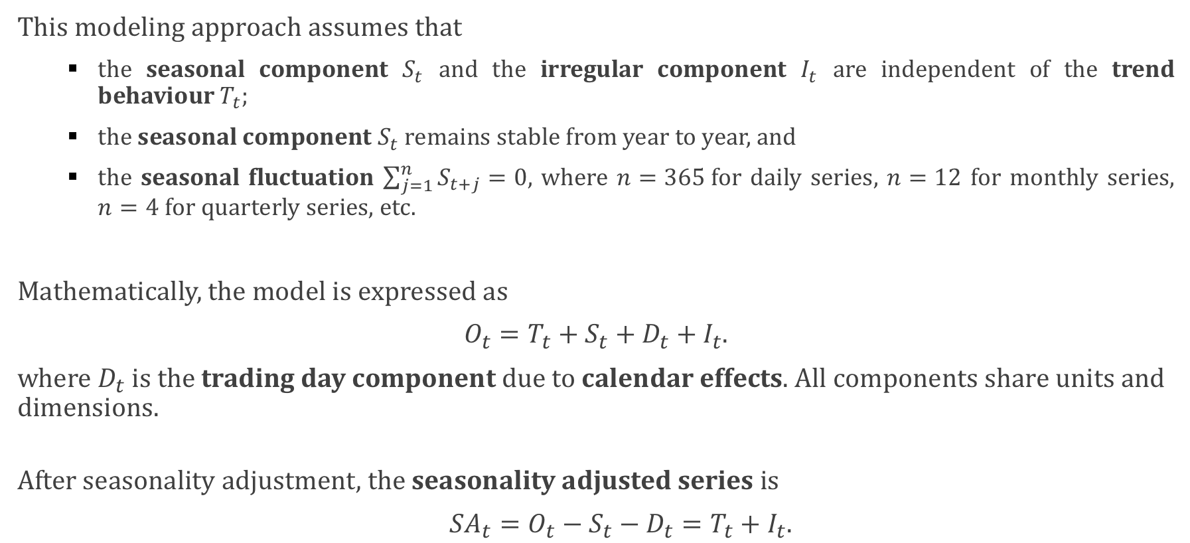
I. Time Series Decomposition Models – Additive
This modeling approach assumes that
the seasonal component $S_{t}$ and the irregular component $I_{t}$ are independent of the trend behaviour $T_{t}$;
the seasonal component $S_{t}$ remains stable from year to year, and
the seasonal fluctuation $\sum_{j=1}^{n}{S_{t+j}=0}$, where $n=365$for daily series, $n=12$ for monthly series, $n=4$ for quarterly series, etc.
Mathematically, the model is expressed as
$O_{t}=T_{t}+S_{t}+D_{t}+I_{t}.$
where $D_{t}$ is the trading day component due to calendar effects. All components share units and dimensions.
After seasonality adjustment, the seasonality adjusted series is
${SA}_{t}={O_{t}−S_{t}−D_{t}=T}_{t}+I_{t}.$

Slide 10
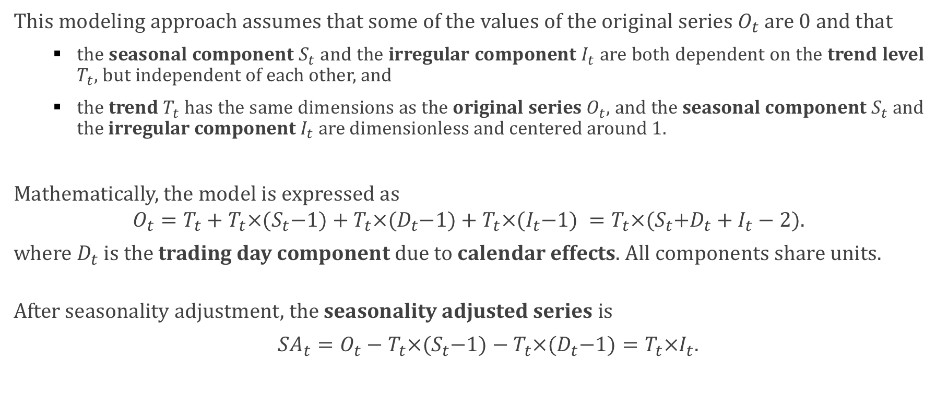
I. Time Series Decomposition Models – Pseudo-Additive
This modeling approach assumes that some of the values of the original series $O_{t}$ are 0 and that
the seasonal component $S_{t}$ and the irregular component $I_{t}$ are both dependent on the trend level $T_{t}$, but independent of each other, and
the trend $T_{t}$ has the same dimensions as the original series $O_{t}$, and the seasonal component $S_{t}$ and the irregular component $I_{t}$ are dimensionless and centered around 1.
Mathematically, the model is expressed as
$$O_{t}=T_{t}+T_{t}×{(S}_{t}−1)+T_{t}×{(D}_{t}−1)+T_{t}×{(I}_{t}−1) =T_{t}×{(S}_{t}+D_{t}+I_{t}−2).$$
where $D_{t}$ is the trading day component due to calendar effects. All components share units.
After seasonality adjustment, the seasonality adjusted series is
${SA}_{t}=O_{t}−T_{t}×{(S}_{t}−1)−T_{t}×{(D}_{t}−1)=T_{t}×I_{t}.$

Slide 11
I. Time Series Decomposition Calendar Effects
A number of monthly and quarterly time series include calendar effects due to the varying lengths of the months, day-of-the week effects and holidays, fixed or moving:
The trading day effect is related to the monthly differences in the numbers of each day of the week from one year to the next (there may be more weekend sales in a month with five weekends). In each month, some days of the week may occur 5 times. The type of theses extra days affect the data for the month. Without an appropriate correction, it becomes impossible to compare monthly estimates from year to year.
Easter is a moving holiday which occurs either in March or April between March 22 and April 25, or in the first or second quarter. Industrial production is lower in months in which Easter falls due to fewer working days. As a result, it needs to be removed before seasonality adjustment. If the Easter moving holiday effect is not corrected, the peaks and troughs due to its effects will be reflected in the final seasonal adjusted series.
Canada Day is a fixed holiday that falls on each year on July 1 (unless July 1 is a Sunday in which case Canada Day is held on July 2). As a consequence, there is always an additional day in the first week of July where businesses are closed and the overwhelming majority of Canadians have the day off, usually modifying their regular activities. An adjustment must be made when looking at daily rates instead of absolute monthly numbers, say.

Slide 12
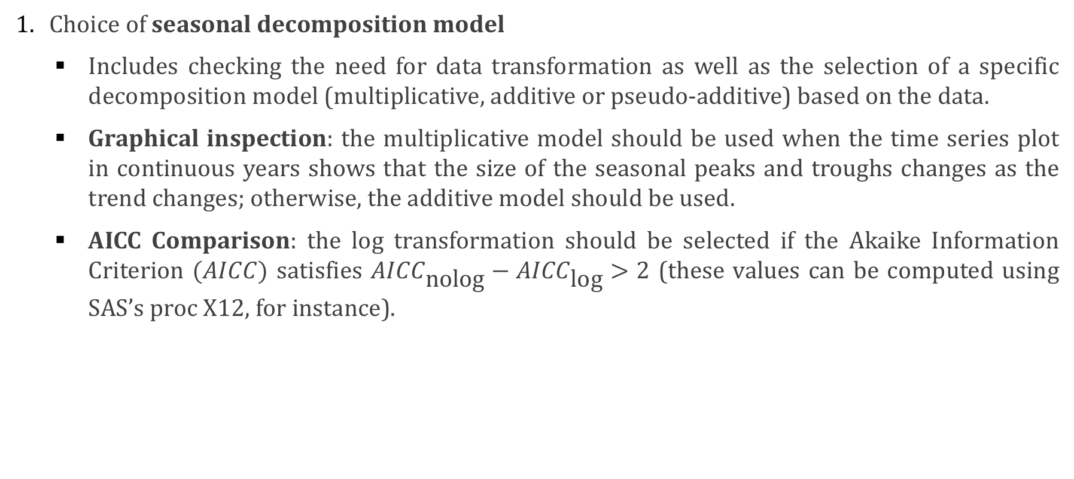
I. Time Series Decomposition Seasonal/Cyclical Adjustment Methodology
Choice of seasonal decomposition model
Includes checking the need for data transformation as well as the selection of a specific decomposition model (multiplicative, additive or pseudo-additive) based on the data.
Graphical inspection: the multiplicative model should be used when the time series plot in continuous years shows that the size of the seasonal peaks and troughs changes as the trend changes; otherwise, the additive model should be used.
AICC Comparison: the log transformation should be selected if the Akaike Information Criterion $(AICC)$ satisfies ${AICC}_{\text{nolog}}−{AICC}_{\text{log}}>2$ (these values can be computed using SAS’s proc X12, for instance).

Slide 13
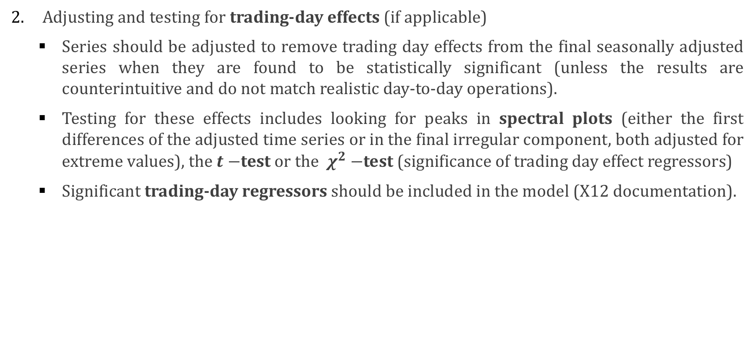
I. Time Series Decomposition Seasonal/Cyclical Adjustment Methodology
Adjusting and testing for trading-day effects (if applicable)
Series should be adjusted to remove trading day effects from the final seasonally adjusted series when they are found to be statistically significant (unless the results are counterintuitive and do not match realistic day-to-day operations).
Testing for these effects includes looking for peaks in spectral plots (either the first differences of the adjusted time series or in the final irregular component, both adjusted for extreme values), the $t−$test or the $χ^{2}−$test (significance of trading day effect regressors)
Significant trading-day regressors should be included in the model (X12 documentation).

Slide 14
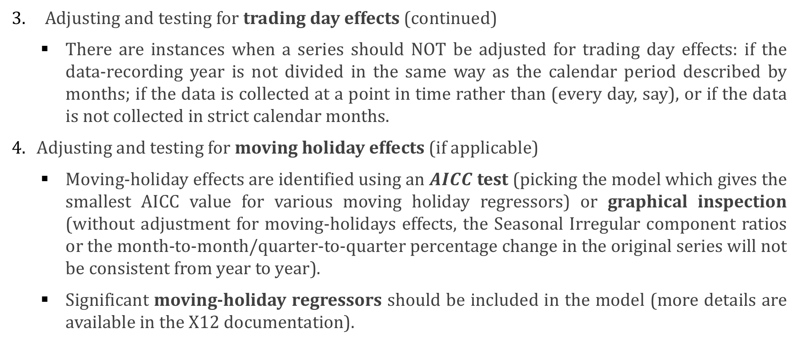
I. Time Series Decomposition Seasonal/Cyclical Adjustment Methodology (continued)
Adjusting and testing for trading day effects (continued)
There are instances when a series should NOT be adjusted for trading day effects: if the data-recording year is not divided in the same way as the calendar period described by months; if the data is collected at a point in time rather than (every day, say), or if the data is not collected in strict calendar months.
Adjusting and testing for moving holiday effects (if applicable)
Moving-holiday effects are identified using an $AICC$ test (picking the model which gives the smallest AICC value for various moving holiday regressors) or graphical inspection (without adjustment for moving-holidays effects, the Seasonal Irregular component ratios or the month-to-month/quarter-to-quarter percentage change in the original series will not be consistent from year to year).
Significant moving-holiday regressors should be included in the model (more details are available in the X12 documentation).

Slide 15
I. Time Series Decomposition Seasonal/Cyclical Adjustment Methodology (continued)
Identifying and adjusting for trend level shifts
Level shifts are abrupt but sustained changes in the underlying level of the time series associated with an unchanged seasonal pattern.
Without accounting for trend level shifts, there may be an increased level of irregularity for the seasonally adjusted series around the level shifts, increasing the volatility of the seasonally adjusted series.
These shifts can be identified using month-to-month/quarter-to-quarter percentage changes in original and seasonally adjusted estimates according to the following criterion: a sudden large increase which is not followed by a corresponding decrease, or vice-versa.

Slide 16
I. Time Series Decomposition Seasonal/Cyclical Adjustment Methodology (continued)
Identifying and adjusting for outliers
Outliers are extreme values that fall outside of the general pattern of the trend and seasonal components, which can be caused by an extreme random effect or an identifiable reason.
Outliers found at the end of the time series may have a large impact on revisions when new data become available.
These can be identified using the table of final weights for the irregular component and the table of residual patterns of the irregular component, according to the following criterion: one or more of the values are 0.

Slide 17
I. Time Series Decomposition Data Quality Issues
Known data quality issues could affect the results of time series analyses:
the method of data collection may lead to unusual effects, especially if collection is made on a non-calendar basis or if there is a lag between activity and measurement;
any change to the method or timing of data collection could lead to the false identification of trend or seasonal breaks;
some series are sensitive to events such as extreme weather, strikes, wars, etc., which could cause breaks or outliers of large magnitude;
at least 5 years worth of data are required to insure stability on future updates, and
at least 10 years worth of data are required to insure that the adjustment of the first year is unlikely to be revised.

Slide 18
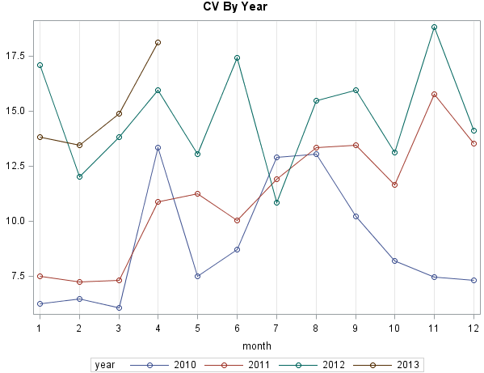
I. Time Series Decomposition Example
Let us illustrate the process of decomposition with an arbitrary time series recording the monthly number of hours for a variable called CV, whose values are shown in the year-by-year plot to the right.
What trend(s) can be found in this data (if any)?
Are there months where the value of CV is “unexpected”? (what might that mean?)

Slide 19
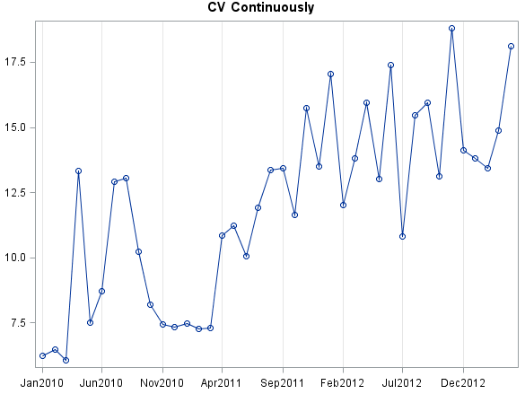
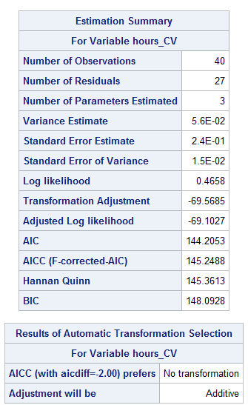
I. Time Series Decomposition Example – Model Selection
The continuous plot shows that the size of the peaks and troughs does not seem to change with changing trends: the additive model is thus selected.
The SAS procedure X12 agrees with that assessment, and further suggests no data transformation.

Slide 20
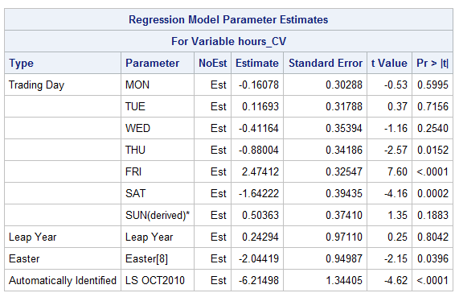
I. Time Series Decomposition Example – Trading-Day and Easter Effects, Level Shifts and Outliers
A spectral plot (not included) suggests that no trading-day effects are found.
At default critical values, the SAS procedure X12 further identifies an Easter effect but no leap year effect, as well as a suspected level shift in October of 2010.
Outliers were not detected.

Slide 21
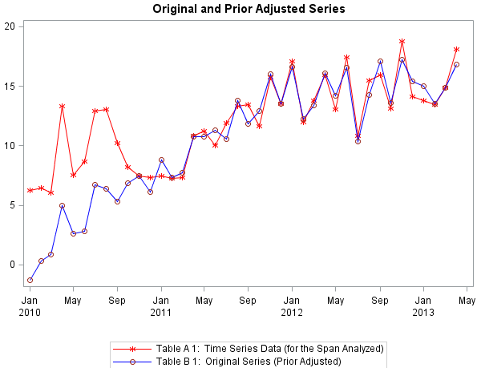
I. Time Series Decomposition Example – Diagnostic Plots
The diagnostic plots are shown on the next few slides: the 2010 CV series is prior-adjusted from the beginning until OCT2010 after the detection of a level shift.

Slide 22
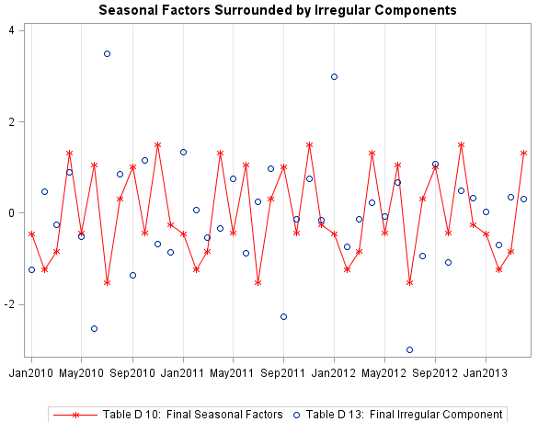
I. Time Series Decomposition Example – Diagnostic Plots
The SI chart shows that there are more than one irregular component which exhibits volatility.

Slide 23
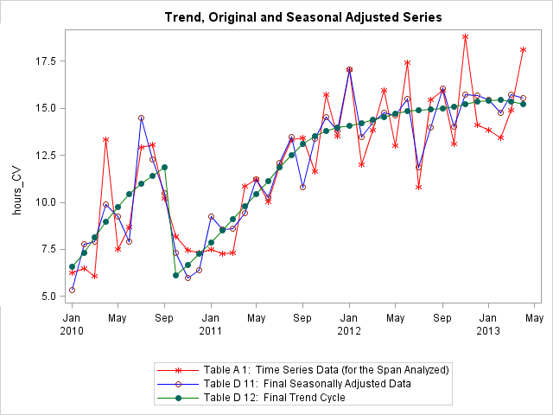
I. Time Series Decomposition Example – Diagnostic Plots
The adjusted series is shown here.

Slide 24
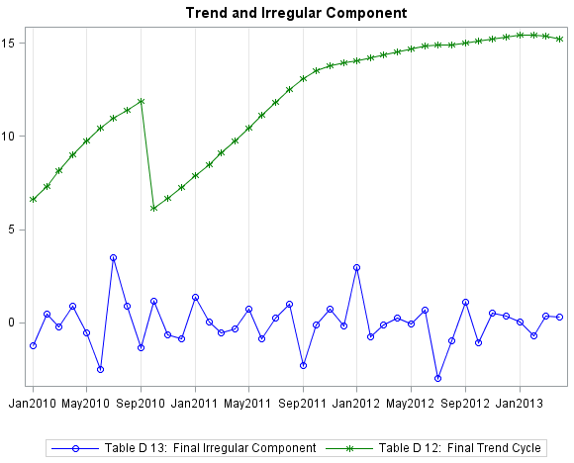
I. Time Series Decomposition Example – Diagnostic Plots
Now the trend and irregular components are shown separately.
So what months should be audited?

Slide 25
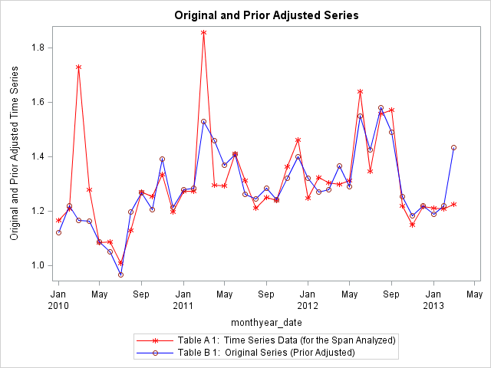
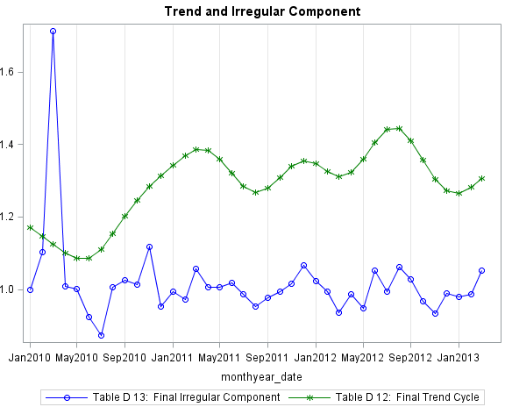
I. Time Series Decomposition Example – Comparison

Slide 26
II. Forecasting Models Basic Notions
Primary focus of forecasting is to try to predict the future using available data (time series or other).
Forecasts tend to be wrong: aggregated forecasts are usually more accurate.
Emphasis should not be placed on a single estimate (the mean): forecasts should also include the standard deviation and an accuracy range.
Accuracy usually decreases when the prediction horizon lies further into the future.
Time series forecasts require the isolation of various patterns in the data: trend, seasonality, cycles, level shifts, irregular components and outliers.

Slide 27
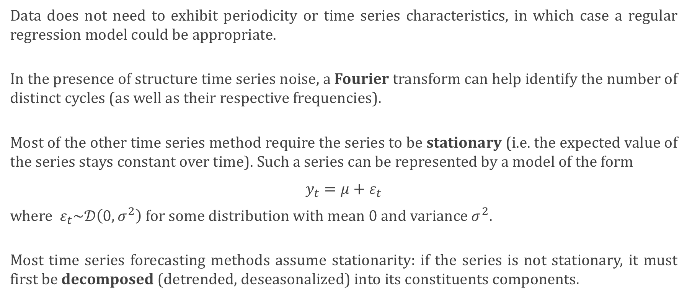
II. Forecasting Models Basic Notions – Methods
Data does not need to exhibit periodicity or time series characteristics, in which case a regular regression model could be appropriate.
In the presence of structure time series noise, a Fourier transform can help identify the number of distinct cycles (as well as their respective frequencies).
Most of the other time series method require the series to be stationary (i.e. the expected value of the series stays constant over time). Such a series can be represented by a model of the form
$y_{t}=μ+ε_{t}$
where $ε_{t}\sim 𝒟\left(0,σ^{2}\right)$ for some distribution with mean 0 and variance $σ^{2}$.
Most time series forecasting methods assume stationarity: if the series is not stationary, it must first be decomposed (detrended, deseasonalized) into its constituents components.

Slide 28
II. Forecasting Models Detrending Time Series Data
Identification of trend in time series is subjective because what appears to be a trend over a short time period may prove to simply be a small fluctuation which could form part of a cycle over the long-term horizon of the series.
Regression models of various complexity levels can be fitted (against time and/or auxiliary variables) to identify possible trends. At long horizons, polynomial response functions explode: if such models must be used, we recommend using linear or quadratic response functions, as slope and concavity might be the best we can hope to detect in light of the previous remark.
In combination with appropriate data transformations (e.g. logarithm, square root, inverse, Box-Cox, etc.), the low order regression models can achieve good results.
Fourier transforms can help identify potential trend and cycles (as well as their respective frequencies), so can a variety of statistical tests (like the Mann-Kendall test, for instance).

Slide 29
II. Forecasting Models Detrending Time Series Data – Methods
There are 4 main approaches to de-trending:
finite differences: iterated differences between subsequent time series observations, which can remove polynomial trends; useful if exact shape of trend cannot be estimated; too high an order may introduce variance inflation; ignores the potential effect of any variable over the trend, save for the passage of time;
curve fitting: regression against time itself, or more complicated models involving auxiliary variables; prior knowledge of the situation can be used to provide an acceptable model which naïve analysis of the data might not be able to suggest; simple regression models may be unrealistic;
filtering and smoothing: various weighted averages of the time series data can be used to compute a filtered series; advantages and disadvantages discussed in the next slides; the trend component output of the X12 procedure on the CV time series in the first section is an example; an explicit functional form for the trend is unlikely to be found;
cubic splines: a separate cubic polynomial is fit continuously to every sequence of three points in the series; the first and second derivatives are continuous at each point; a “spline parameter,” which depends on the relative importance given to “smoothness” and “goodness-of-fit” of the curve, is required to specify the spline flexibility.

Slide 30
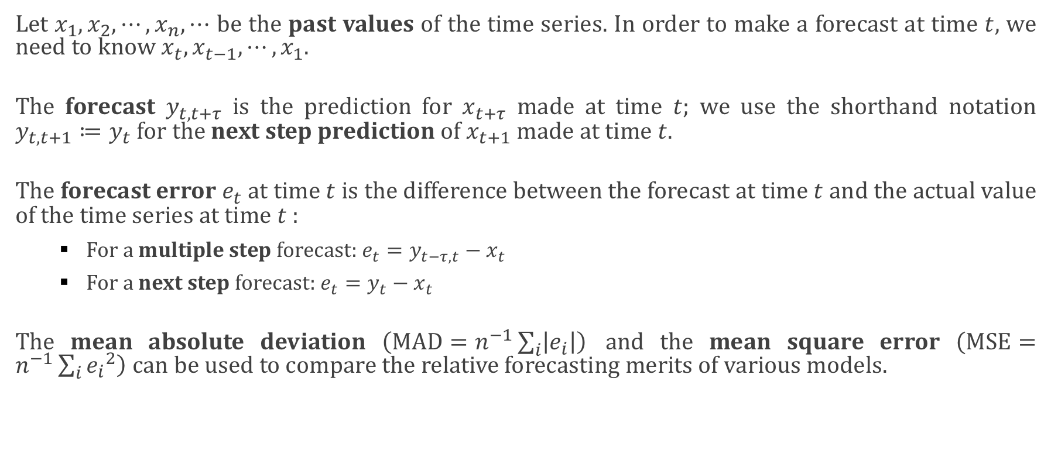
II. Forecasting Models Notation and Forecast Evaluation
Let $x_{1},x_{2}, ⋯,x_{n}, ⋯$ be the past values of the time series. In order to make a forecast at time $t$, we need to know $x_{t},x_{t−1}, ⋯,x_{1}.$
The forecast $y_{t,t+τ}$ is the prediction for $x_{t+τ}$ made at time $t$; we use the shorthand notation $y_{t,t+1}≔y_{t}$ for the next step prediction of $x_{t+1}$ made at time $t$.
The forecast error $e_{t}$at time $t$ is the difference between the forecast at time $t$ and the actual value of the time series at time $t$:
For a multiple step forecast: $e_{t}=y_{t−τ,t}−x_{t}$
For a next step forecast: $e_{t}=y_{t}−x_{t}$
The mean absolute deviation $\left(\text{MAD}=n^{−1}\sum_{i}{\left|e_{i}\right|}\right)$ and the mean square error $\left(\text{M}\text{SE}=n^{−1}\sum_{i}{{e_{i}}^{2}}\right)$ can be used to compare the relative forecasting merits of various models.

Slide 31
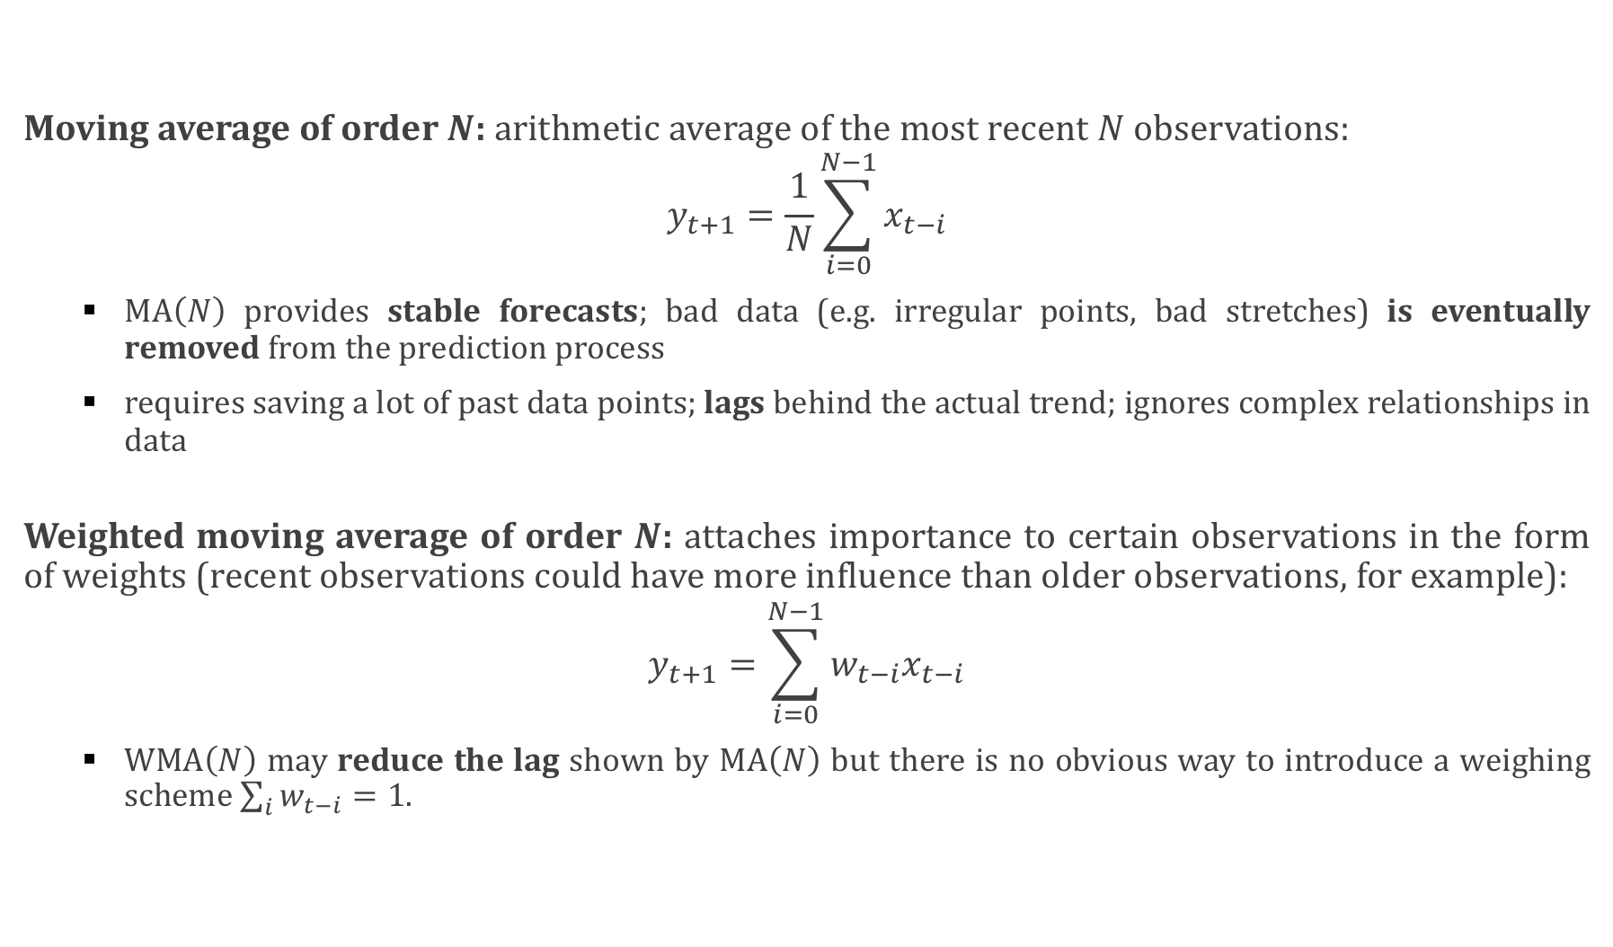
II. Forecasting Models Filtering Methods
Moving average of order $N$: arithmetic average of the most recent $N$ observations:
$$y_{t+1}=\frac{1}{N}\sum_{i=0}^{N−1}{x_{t−i}}$$
$\text{MA}\left(N\right)$ provides stable forecasts; bad data (e.g. irregular points, bad stretches) is eventually removed from the prediction process
requires saving a lot of past data points; lags behind the actual trend; ignores complex relationships in data
Weighted moving average of order $N$: attaches importance to certain observations in the form of weights (recent observations could have more influence than older observations, for example):
$$y_{t+1}=\sum_{i=0}^{N−1}{{w_{t−i}x}_{t−i}}$$
$\text{W}\text{MA}\left(N\right)$ may reduce the lag shown by $\text{MA}\left(N\right)$ but there is no obvious way to introduce a weighing scheme $\sum_{i}{w_{t−i}}=1$.

Slide 32
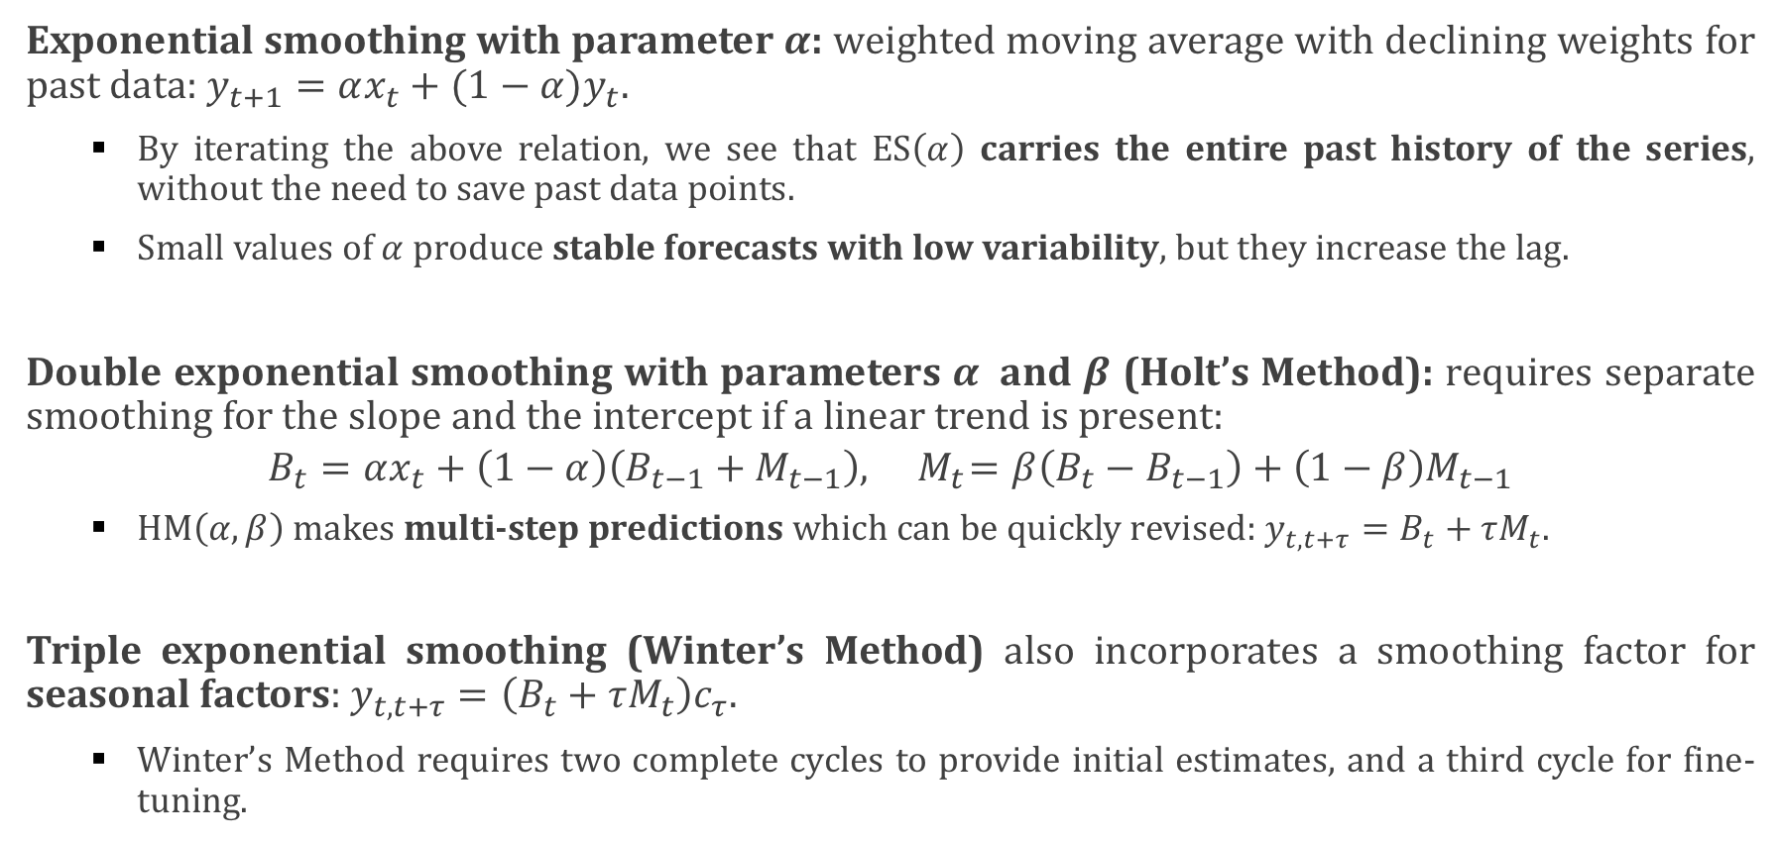
II. Forecasting Models Filtering Methods (continued)
Exponential smoothing with parameter $α$: weighted moving average with declining weights for past data: $y_{t+1}=αx_{t}+(1−α)y_{t}$.
By iterating the above relation, we see that $\text{ES}\left(α\right)$ carries the entire past history of the series, without the need to save past data points.
Small values of $α$ produce stable forecasts with low variability, but they increase the lag.
Double exponential smoothing with parameters $α$ and $β$ (Holt’s Method): requires separate smoothing for the slope and the intercept if a linear trend is present:
$$B_{t}=αx_{t}+\left(1−α\right)\left(B_{t−1}+M_{t−1}\right),{ M}_{t}=β\left(B_{t}−B_{t−1}\right)+\left(1−β\right)M_{t−1}$$
$\text{HM}\left(α,β\right)$ makes multi-step predictions which can be quickly revised: $y_{t,t+τ}=B_{t}+τM_{t}$.
Triple exponential smoothing (Winter’s Method) also incorporates a smoothing factor for seasonal factors: $y_{t,t+τ}=\left(B_{t}+τM_{t}\right)c_{τ}$.
Winter’s Method requires two complete cycles to provide initial estimates, and a third cycle for fine-tuning.

Slide 33
II. Forecasting Models Other Considerations
Methods that are too sophisticated can be unreliable over the long-term.
Another family of methods to consider: Box-Jenkins, which require substantial data history, use the correlation structure of the data (none of the filtering methods do) and can provide much-improved forecasts in some situations.
Bayesian inference and Monte-Carlo Markov Chains could also be used if we have some prior information/belief regarding the structure of the time series and the auxiliary variables, but there is some controversy regarding non-frequentist approaches.

Slide 34
II. Forecasting Models Example
Monthly sunspot data….

Slide 35
III. Dealing With Missing Data
Most (but not all!) statistical procedures require “rectangular” data: each record having the same number of observation at each time step.
Furthermore, missing data is a significant feature of the dataset.
For that reason, the first attempt at solving the missing data problem is to impute them (i.e. provide values for missing data).
Care must be taken as imputed values cannot add new knowledge to the dataset which was not originally present in the dataset. Furthermore, imputation can add bias to the data if not done properly.
Numerous imputation methods exist (last observation carried forward, mean imputation, regression imputation, multiple imputation, etc. ).

Slide 36
III. Dealing With Missing Data (continued)
Outright removal (list deletion) should NOT be considered, as this can introduce bias from which the experiment simply cannot survive.
Multiple imputation extracts useful information from the available observations: by completing the dataset (in potentially different ways) a number of times (typically 5-10). Analyses can then be run on each complete dataset, and the results are combined statistically: the estimates incorporate the uncertainty found in the dataset. Works well for up to 30-40 variables. Poorly suited to datasets with endemic missing values.
There exists software that can help with multiple imputation, notably Amelia (see links in the references).
Certain time series methods also work with missing values (X12 in SAS or R, the Kalman filter); others do not. MATLAB’s getdatasamples method allows the user to re-sample a time series at missing values (using various interpolation methods).

Slide 37
III. Dealing With Missing Data (continued)
When time series values are missing systematically or in large number, the problem of imputation may reduce to a problem of forecasting.
Better suggestions can be provided once specific time series are exhibited.

Slide 38
IV. Automated Trend Extraction
Ideally, trend extraction should not be automated. There are ways to program the methods (such as proc X12 in SAS in R) to automatically select the model (additive, multiplicative, etc.), to search for outliers and level shifts, etc., but the tests that are used are NOT perfect and visual examination is typically needed to confirm the procedure’s decisions.
That being said, it is possible to provide an algorithm that one would expect to de-trend and de-seasonalize a time series most of the time (the caveat being that unless one verifies the results on a given time series, one cannot be sure that the assumptions built into the algorithms applied to that time series).
MATLAB has a time series module; some of the documentation gives suggestions as to how to automate trend extraction. But MATLAB is not a native time-series environment: SAS or R are preferred alternatives.
A possible algorithm can be prepared once specific time series are exhibited.

Slide 39
References
J.D.Ashley, Why Seasonal Adjustment, Catherine Hood Consulting (online).
C.C.Hood, Seasonal Adjustment and Time Series FAQ, Catherine Hood Consulting (online).
B.C.Monsell, A Painless Introduction to Seasonal Adjustment, U.S. Census Bureau.
H.A.Latane [1942], Seasonal Factors Determined by Difference from Average of Adjacent Months, J.Am.Stat.Assoc, Dec.
D.F.Findley, C.C.Hood, X-12-ARIMA and its Application to Some Italian Indicator Series, U.S. Bureau of the Census.
D.F.Findley, B.C.Monsell, Bell, Otto and Chen [1998], New Capabilities and Methods of the X-12-ARIMA Seasonal Adjustment Program, U.S. Bureau of the Census.
An Introductory Course on Time Series Analysis, Australian Bureau of Statistics.
Seasonal Adjustment of Economic Time Series, Singapore Department of Statistics.
T.Jackson, M.Leonard, Seasonal Adjustment Using The X12 Procedure, SAS Institute.

Slide 40
References
A.J.Calise, J.Earley, Detecting Structural Change Using SAS/ETS Procedures.
A.Milhoj, Practical Time Series Analysis Using SAS, SAS Institute.
Time Series Analysis Branch, Guide to Seasonal Adjustment with X-12-ARIMA, Office for National Statistics, UK.
W.S.Cleveland, S.J.Devlin [1982], Calendar Effects in Monthly Time Series: Modeling and Adjustment, J.Am.Stat.Assoc., Vol. 77, no. 279, pp. 520-528.
Estimating and Removing the Effects of Chinese New Year and Ramadan to Improve the Seasonal Adjustment Process, Australian Economic Indicators, November 2005.
P.Boily, Y.Huang [2013], Analysis of Fluidity Indicators and Seasonality Adjustment for Containers Transit Times in a Multi-Modal Supply Chain Network, Centre for Quantitative Analysis and Decision Support.
R.H.Shumway, D.S.Stoffer [2010], Time Series Analysis and its Applications, Springer.

Slide 41
References
R.Lindeke, Forecasting Models, Lecture Notes.
N.Silver [2012], The Signal and the Noise: Why So Many Predictions Fail – and Others Don’t, Penguin Publishing.
D.Meko, Notes on Detrending, University of Arizona (online).

Slide 42
References
Wikipedia’s entry on the Kalman Filter (https://en.wikipedia.org/wiki/Kalman_filter)
D.S.C.Fung, Methods for the Estimation of Missing Values in Time Series (http://ro.ecu.edu.au/cgi/viewcontent.cgi?article=1063&context=theses)
O.Anava, E.Hazan, A.Zeevi, Online Time Series Prediction with Missing Data (http://jmlr.org/proceedings/papers/v37/anava15.pdf)
MATLAB’s fillts method (http://www.mathworks.com/help/finance/fillts.html)
J.Honaker, G.King, What to do about Missing Values in Time Series Cross-Section Data (http://tercer.bol.ucla.edu/papers/pr.pdf)
J.Honaker, G.King, M.Blackwell, Amelia II: a Program for Missing Data (http://gking.harvard.edu/amelia)
MATLAB’s resample method (http://www.mathworks.com/help/matlab/ref/timeseries.resample.html)

Slide 43
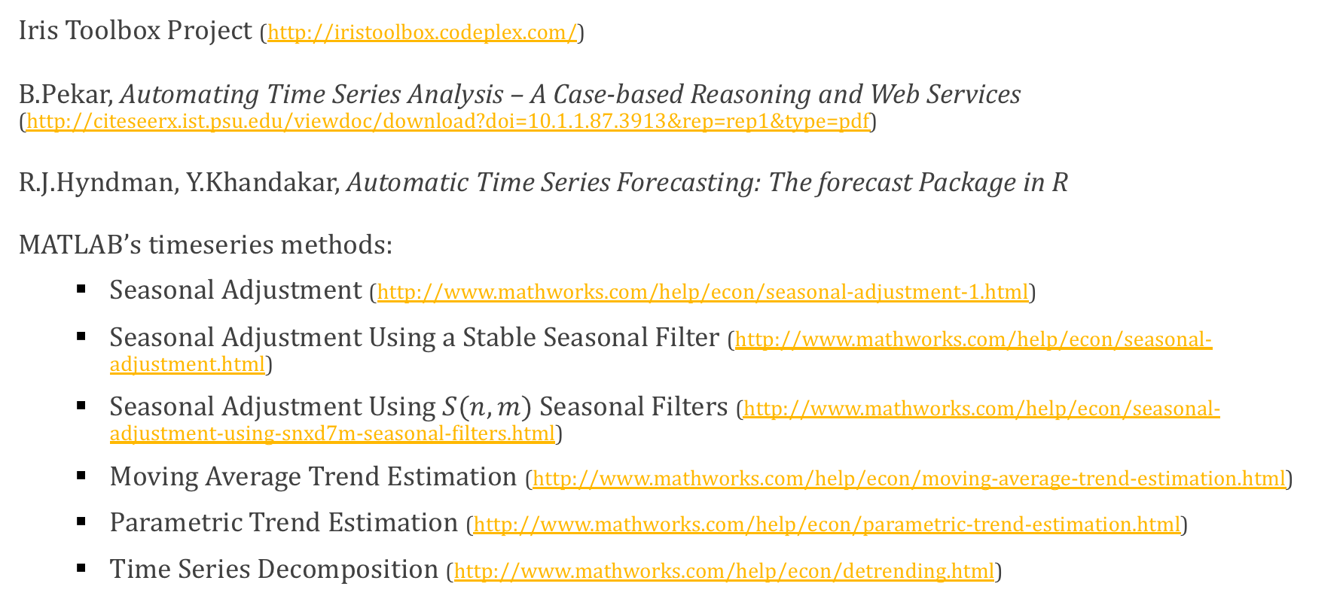
References
Iris Toolbox Project (http://iristoolbox.codeplex.com/)
B.Pekar, Automating Time Series Analysis – A Case-based Reasoning and Web Services (http://citeseerx.ist.psu.edu/viewdoc/download?doi=10.1.1.87.3913&rep=rep1&type=pdf)
R.J.Hyndman, Y.Khandakar, Automatic Time Series Forecasting: The forecast Package in R
MATLAB’s timeseries methods:
Seasonal Adjustment (http://www.mathworks.com/help/econ/seasonal-adjustment-1.html)
Seasonal Adjustment Using a Stable Seasonal Filter (http://www.mathworks.com/help/econ/seasonal-adjustment.html)
Seasonal Adjustment Using $S(n,m)$ Seasonal Filters (http://www.mathworks.com/help/econ/seasonal-adjustment-using-snxd7m-seasonal-filters.html)
Moving Average Trend Estimation (http://www.mathworks.com/help/econ/moving-average-trend-estimation.html)
Parametric Trend Estimation (http://www.mathworks.com/help/econ/parametric-trend-estimation.html)
Time Series Decomposition (http://www.mathworks.com/help/econ/detrending.html)

